Slide 1
A gap between radiation science and humanity
Ohtsura Niwa
Radiation Effects Research Foundation

Slide 2
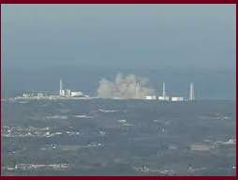
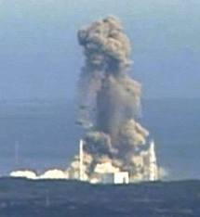
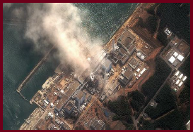
When the Fukushima accident took place
March 12, hydrogen explosion
of reactor unit 1
March 14, hydrogen explosion
of reactor unit 3
Many radiation professionals thought that they can help people in Fukushima with their scientific knowledge.
But we were too naïve!
March 14, after the explosion

Slide 3
Ambient doses in Fukushima
（μSv/hr）
Iwaki
Iitate
Minamisoma
Fukushima
3/11 3/15 3/19 3/23 4/1 4/9

Slide 4
Dose to the people from the external exposures
mSv/year

Slide 5
Experience of my side in Fukushima
How my lectures in Fukushima did?
→ it did badly and met with strong skepticisms
and distrusts of people
Why?
→ I was too eager to transfer the scientific
knowledge of radiation science, without trying to
understand the needs of people in Fukushima
ironically, activists did well since their words
were in line with the people’s concern
What should I do?
I helped ICRP to start Dialogue Seminar and I
myself moved to Fukushima to live

Slide 6
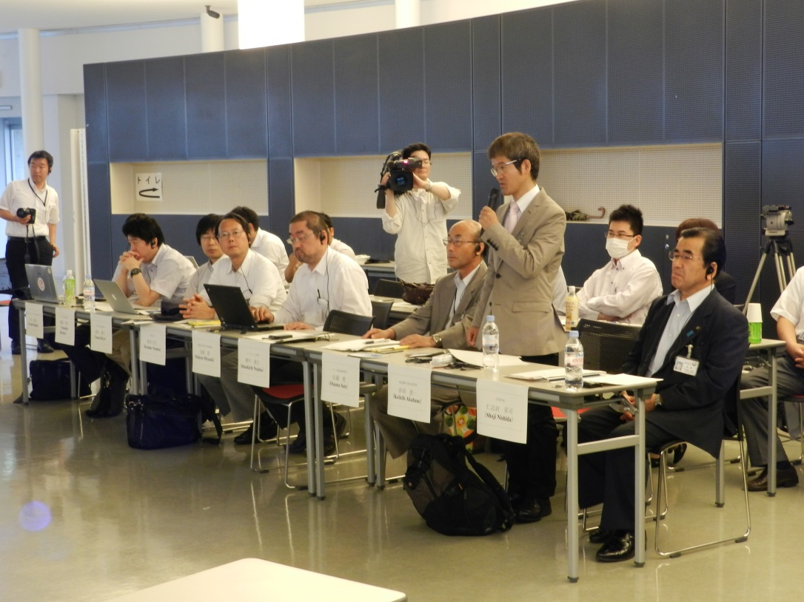
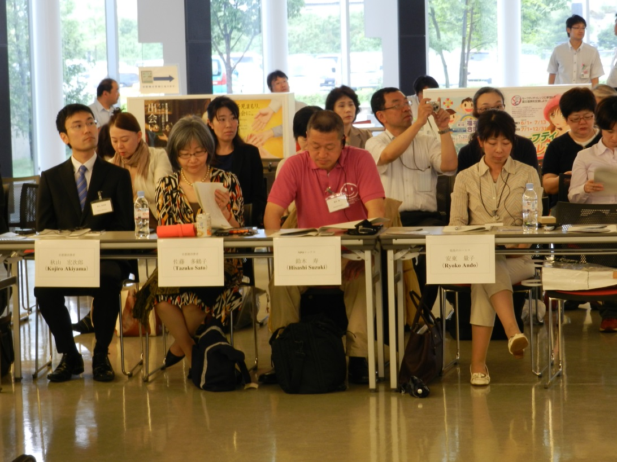
ICRP’s action: Dialogue Seminar
19 times since November 2011
Listening to people on a range of subjects; living in the affected lands, food, education, return or not, culture & heritage, Iitate,
Minamisoma, radiation dose,
Notes:
6

Slide 7
You are the main player of your daily life
house
cat
child
Working place
dog
You
partner
parent
friend
friend
Your daily life
environment

Slide 8
Radiation becomes the main player of your life
house
cat
Working place
child
dog
You
partner
parent
friend
friend
Your daily life
environment

Slide 9
What we learned?
What to be done on people in the affected land
→Help people to regain the position of main
player of their life
How?
→ Help them to take action on their surroundings
such as radiation dose measurement around
their living place and food to eat
Final goal
→ help people to gain freedom from radiation

Slide 10
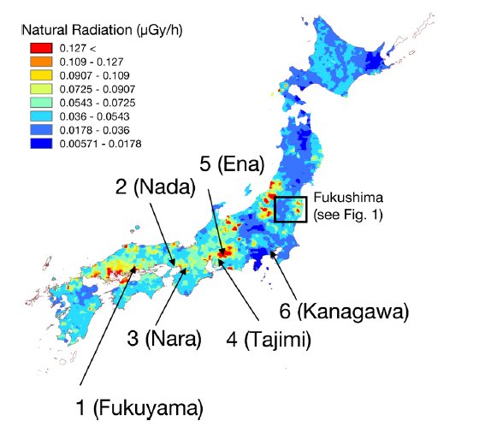
Dosimetry project of Fukushima High School

Slide 11
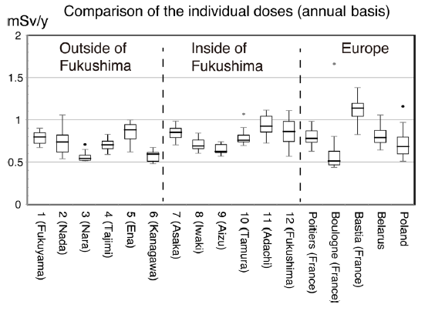
Individual dose (mSv/year)

Slide 12
The last thing we should be aware of;
Intrinsic gap between science and people
Science seeks for generic rules,
while the public relies on individual rules
Science relies on objective approaches,
while the public relies on subjective judgements
Science handle risk handled in proportion,
while the public perceive the risk as all or none
Scientists should be aware of the gap
The gap is filled by empathy by science side
The gap is filled by trust from the public side

Slide 13
Spring in Date city

Slide 14
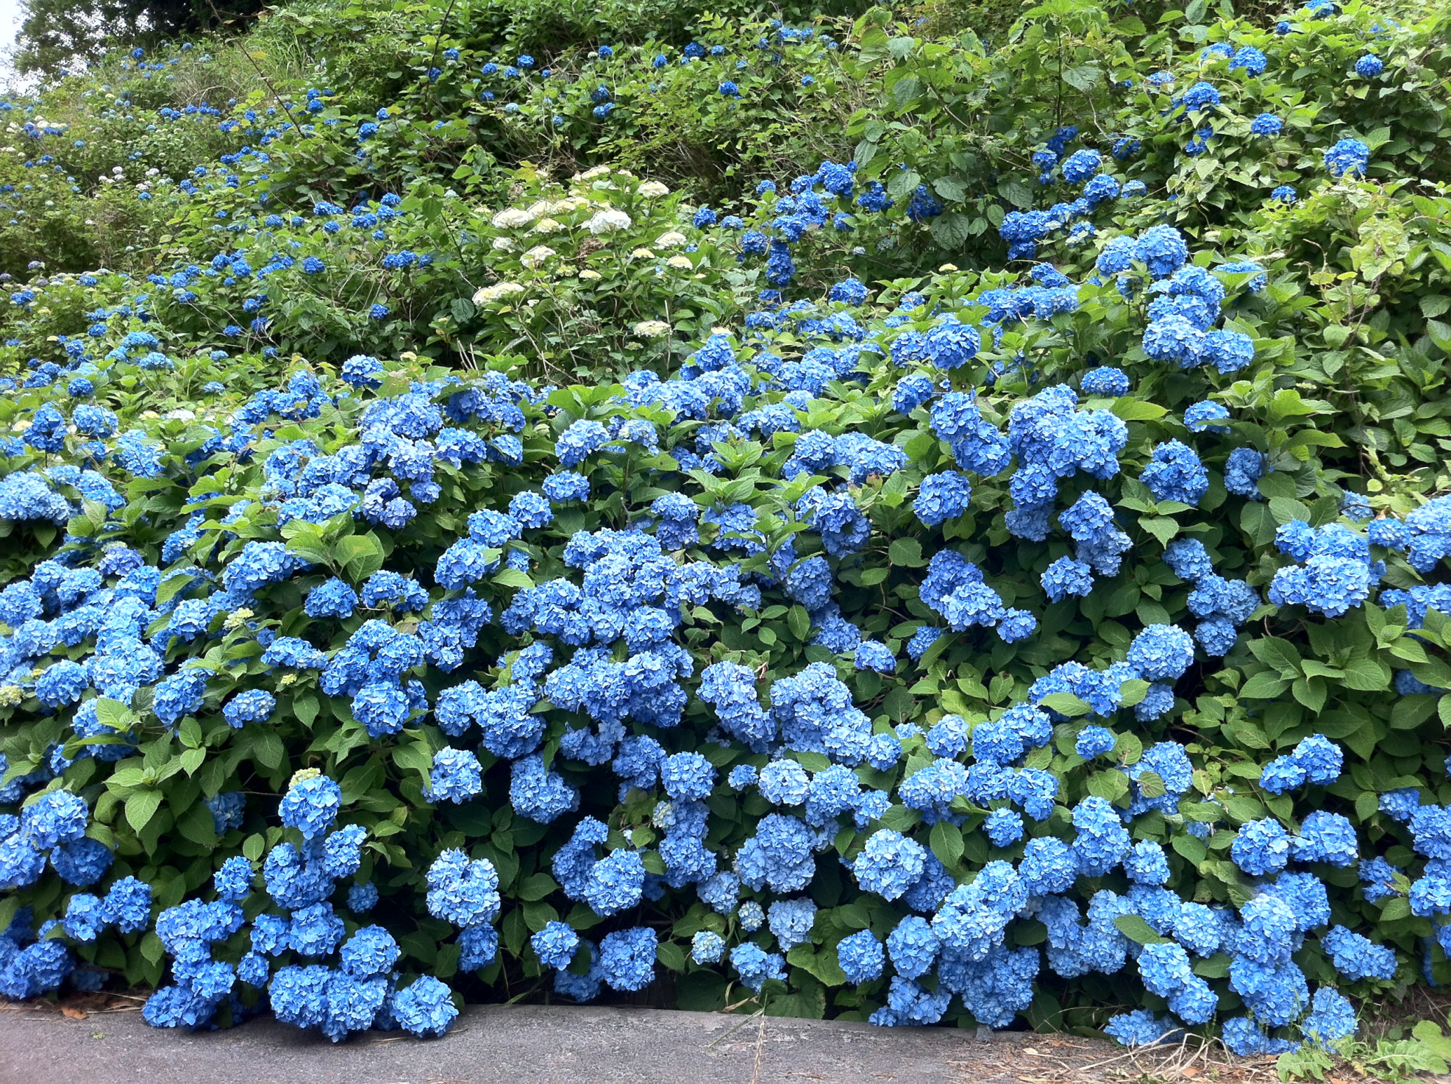
Early summer in Suetsugi
14
14

